Slide 1
CMIO Role Alignment Intro to Data Standards
Bob Marshall, MD MPH MISM FAAFP Program Director, Clinical Informatics Fellowship

Slide 2
Objectives
Review CMIO priorities, reporting structure, types of backgrounds, optimization, and bimodal thinking
Provide an overview of data standards, why they are important, provide some examples, discuss interchange standards, and go over some basics of terminologies

Slide 3
CMIO Priorities
Provide leadership, collaboration and liaison/ communication functions around a specific set of IT priorities:
IT governance and clinical steering committee leadership/support
New/replacement EHR planning, procurement, stabilization and added functionality
Standardization, enhancement and optimization of the EHR (around workflow, content and process for quality and cost)
Life cycle management leadership for EHR content, including order sets, clinical decision support and documentation templates

Slide 4
CMIO Priorities cont
Analytics, data warehouse and related support, including data stewardship and standardization…as well as reporting compliance
Clinical documentation improvement program and tool support, with a related role in revenue optimization
Additional priorities
Establish and execute telemedicine and virtual care strategy
Population health management: EHR registries, tools and analytics
Patient informatics and patient engagement tools, techniques, innovations and analytics
Contribute to future digital hospital/digital health business strategies and investment

Slide 5
To Whom Should the CMIO Report
It depends
Maybe the CIO; maybe the CMO; maybe both
Key to CMIO success is a strong relationship with the CIO
Post-deployment, EHR focus changes to usability and realizing enterprise value
This focus would align more closely with the CMO than the CIO
However, a strong CIO relationship is still critical to success
CMIO is often paired with the Quality folks under the CMO…the “Management Trilogy”
CMO alignment also eases the transition to value-based care

Slide 6
CMIO Background
Majority come from IM, FM, Pediatrics, Infectious Disease, Emergency Medicine and Pulmonary/Critical Care
Surgical CMIO’s are uncommon
Only 13% do not have a Master’s degree, Ph.D. or some formal informatics training (like the 10x10 course)
By mid-2015, 48% of CMIO’s were Board Certified in Clinical Informatics
Most CMIO’s are full time (>60% of time spent in CMIO role)
Most still practice medicine part-time

Slide 7
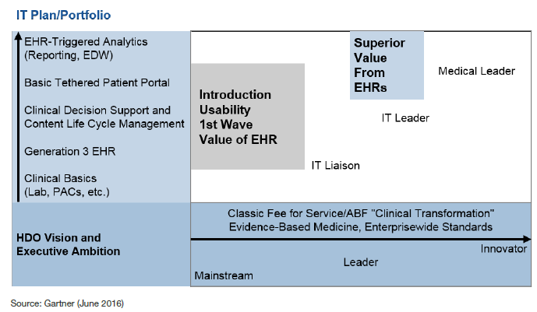
Classic Generation 3 EHR View of Medical/Clinical Informatics Role

Slide 8
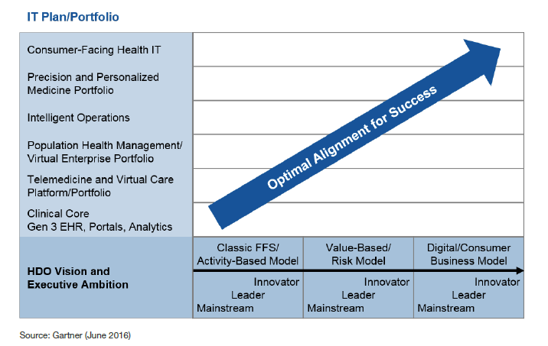
Framework for Defining CMIO Organization Roles and Responsibilities

Slide 9
Bimodal Thinking in Health IT
Bimodal IT is the practice of managing two separate, coherent modes of IT delivery, one focused on stability and cohesion, and the other focused on a digital healthcare future vision
Moving to a bimodal approach can create tensions among and between the medical service line, medical informatics and IT leadership.
This is especially true if top executives don't recognize just how different the digital business vision and its execution must be, and find a leader for both.
This is not just making more time in already busy days for strategy, but rather layering a new roadmap for enterprise architecture and digital business investments

Slide 10
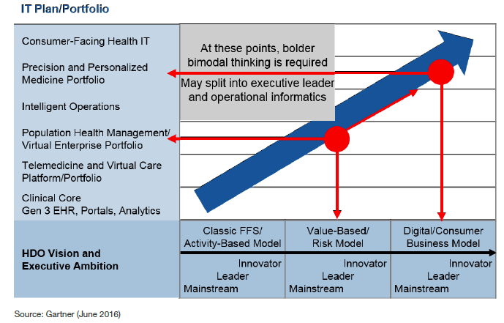
Assessing If/When Bimodal Medical Informatics Is Needed

Slide 11
Intro to Data Standards

Slide 12
Why do we Need Data Standards
Today’s current healthcare landscape consists of a variety of care settings and stakeholders, which all leverage a number of different information systems in their delivery of care
An individual may touch a number of different systems that must be able to communicate throughout his or her health journey
In healthcare, standards provide a common language and set of expectations that enable interoperability between these systems and/or devices

Slide 13
What are Data Standards
Data standards are "documented agreements on representations, formats, and definitions of common data”
Data standards provide a method to codify invalid, meaningful, comprehensive, and actionable ways, information captured in the course of doing business
Rules to describe how the data is recorded to ensure consistency across multiple sources is another way to think of data standards
Without data standards and data quality, the future of interoperability is bleak

Slide 14
Major Healthcare Data Standards
International Classification of Diseases (ICD)
Logical Observation Identifiers Names and Codes (LOINC)
The LOINC database contains the usual categories of chemistry, hematology, serology, microbiology, toxicology; as well as categories for drugs and the cell counts, antibiotic susceptibilities, and more.
Health Level Seven (HL7)
A coordinated message-based connection between two systems that allows information to be exchanged reliably between application programs

Slide 15
Major Healthcare Data Standards cont
Systematized Nomenclature of Medicine (SNOMED)
Designed as a comprehensive nomenclature of clinical medicine to accurately store and/or retrieve records of clinical care in human and veterinary medicine
Offers a standard-based foundation for different functions e.g. collection of a variety of clinical information, linked to clinical knowledge bases, information retrieval, data aggregation, analyses, exchange, etc.
Statistical Data and Metadata Exchange (SDMX)
Provides standard formats for data and metadata, together with content guidelines and an IT architecture for exchange of data and metadata

Slide 16
Data Interchange Standards
Message format standards
Facilitate interoperability through the use of common encoding specifications, information models for defining relationships between data elements, document architectures, and clinical templates for structuring data as they are exchanged
Document Architecture
Representing electronic clinical data such as discharge summaries or progress notes and patient safety reports requires a standardized document architecture
Clinical Templates
A template in the broadest sense is simply a constraint on a more generic model that permits, among other things, the definition of a complex object (blood chemistry/heart murmur)

Slide 17
Data Interchange Standards cont
User Interface
The medical device industry employs a voluntary standard for human factors design established by the Association for the Advancement of Medical Instrumentation (AAMI) and approved by the American National Standards Institute (ANSI) – ANSI/AAMI HE74
See next slide for the process
HL7 has taken an approach to data integration at the visual level by way of the user interface (ANSI-certified HL7 Context Manager standard)
Presented in two slides

Slide 18
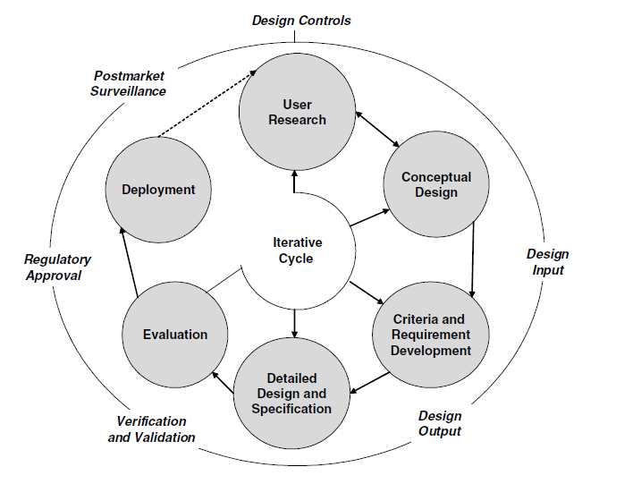
HE74 Standard
- HFE Process

Slide 19
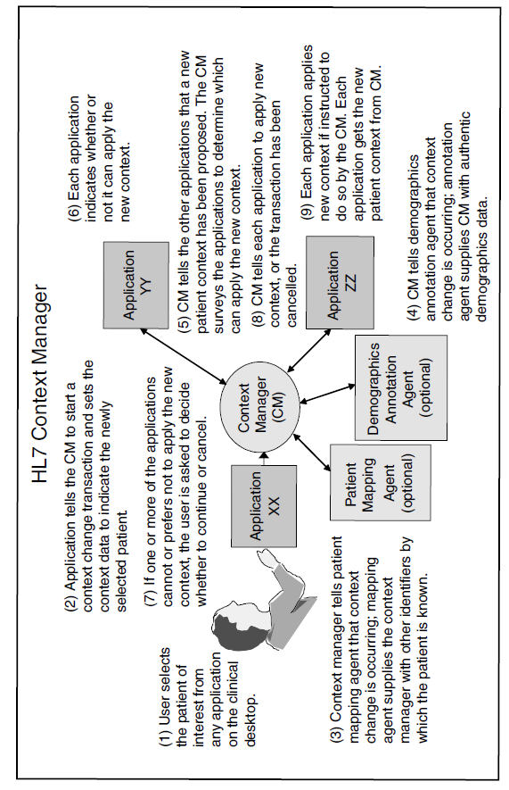

Slide 20
Data Interchange Standards cont
Patient Data Linkage
While not a data standard in the traditional sense, being able to link a patient’s health care data from one departmental location or site to another unambiguously is important for maintaining the integrity of patient data and delivering safe care

Slide 21
Terminologies
Standardized terminologies facilitate electronic data collection at the point of care; retrieval of relevant data, information, and knowledge (i.e., evidence); and data reuse for multiple purposes, such as automated surveillance, clinical decision support, and quality and cost monitoring
To promote patient safety and enable quality management, standardized terminologies that represent the focus (e.g., medical diagnosis, nursing diagnosis, patient problem) and interventions of the variety of clinicians involved in health care as well as data about the patient (e.g., age, gender, ethnicity, severity of illness, preferences, functional status) are necessary

Slide 22
Terminologies cont
Twenty-five years of effort has led to the development of standardized terminologies for the core phenomena of clinical practice:
(1) diagnoses, symptoms, and observations (e.g., medical diagnoses, nursing diagnoses, problem list);
(2) interventions, procedures, and treatments, including those focused on prevention and health promotion; and
(3) health outcomes
While no single current terminology has the breadth and depth needed for health care data, the National Library of Medicine (NLM) houses the world’s largest database of standardized terminologies from a broad array of digital knowledge sources—the Unified Medical Language System (UMLS)

Slide 23
Representation of Clinical Domains
Terminology must serve the purposes of decision support tools, the EHR and knowledge resources
EHR terminology efforts have focused on how to represent the history, findings, diagnoses, management, and outcomes of patients in a way that can preserve clinical detail and identify characteristics that enable improved risk adjustment, the development of common guidelines, aggregate outcome analyses and shared decision support rules

Slide 24
Representation of Clinical Domains cont
A number of technical criteria must be met for terminologies to function in a way that serve as the backbone of clinical information systems
The most basic criteria for a controlled medical vocabulary include domain completeness, non-redundancy, synonymy, non-ambiguity, multiple classification, consistency of views, and explicit relationships
Lots more work to be done in this area as part of the work by ONC’s Consolidated Health Informatics initiative

Slide 25
Conclusion
There is still plenty of work in implementing, updating, adding or replacing EHR’s
However, most mature organizations now have CMIO’s who do much more and are more likely aligned with the clinical side of the house
Data standards are important for interoperability
There are too many data standards, often in competition, and the real problem is limiting the number and focusing only on those that are most useful and effective

Slide 26

Questions & Discussion

